Slide 1
Presentation
on
HEAT ENGINE
PREPARED BY:
CHAUHAN SATISH(EN. NO:131150102007)
GAUTAM ASHISH(EN. NO: 131150102010)
KETUL PATEL(EN. NO: 131150102013)
SUB: E.M.E
DEPARTMENT:AUTOMOBILE
SWAMINARAYAN COLLEGE OF ENGG. & TECH.,SAIJ

Slide 2
Heat Engines
A gasoline engine is a form of a heat engine, e.g. a 4-stroke engine
INTAKE stroke:
the piston descends from the top to the bottom of the cylinder, reducing the pressure inside. A mixture of fuel and air, is forced by atmospheric pressure into the cylinder through the intake port. The intake valve then close.
COMPRESSION stroke:
with both intake and exhaust valves closed, the piston returns to the top of the cylinder compressing the fuel-air mixture.
POWER stroke:
the compressed air–fuel mixture in a gasoline engine is ignited by a spark plug. The compressed fuel-air mixture expand and move the piston back
EXHAUST stroke:
during the exhaust stroke, the piston once again returns to top while the exhaust valve is open and expel the spent fuel-air mixture out through the exhaust valve(s).
Notes:
Crank the starter

Slide 3
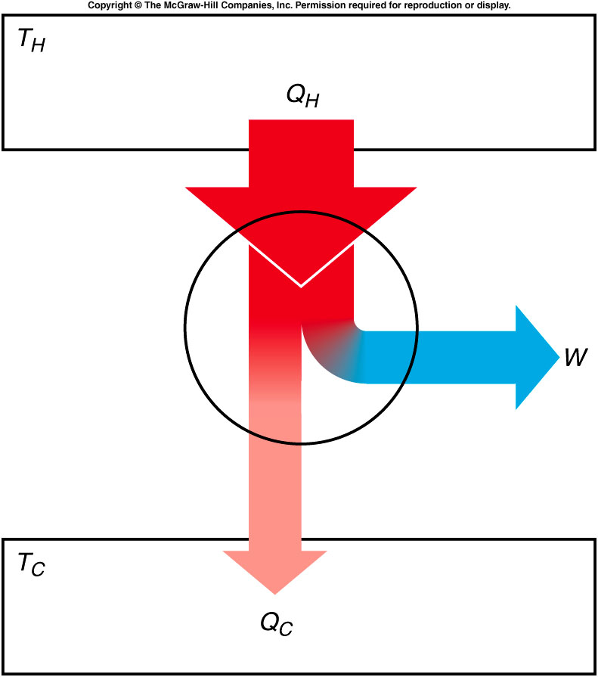
Efficiency
Efficiency is the ratio of the net work done by the engine to the amount of heat that must be supplied to accomplish this work.

Slide 4
Carnot Engine
The efficiency of a typical automobile engine is less than 30%.
This seems to be wasting a lot of energy.
What is the best efficiency we could achieve?
What factors determine efficiency?
The cycle devised by Carnot that an ideal engine would have to follow is called a Carnot cycle.
An (ideal, not real) engine following this cycle is called a Carnot engine.
Notes:
Can not be 100% efficiency since you can not completely control heat which is the kinetic energy of each moleclur.

Slide 5
Different Thermal Process
If the process is adiabatic, no heat flows into or out of the gas
In an isothermal process, the temperature does not change.
The internal energy must be constant.
The change in internal energy, ΔU, is zero.
If an amount of heat Q is added to the gas, an equal amount of work W will be done by the gas on its surroundings, from ΔU = Q - W.
In an isobaric process, the pressure of the gas remains constant.
The internal energy increases as the gas is heated, and so does the temperature.
The gas also expands, removing some of the internal energy.
Experiments determined that the pressure, volume, and absolute temperature of an ideal gas are related by the equation of state:
PV = NkT where N is the number of molecules
and k is Boltzmann’s constant.

Slide 6
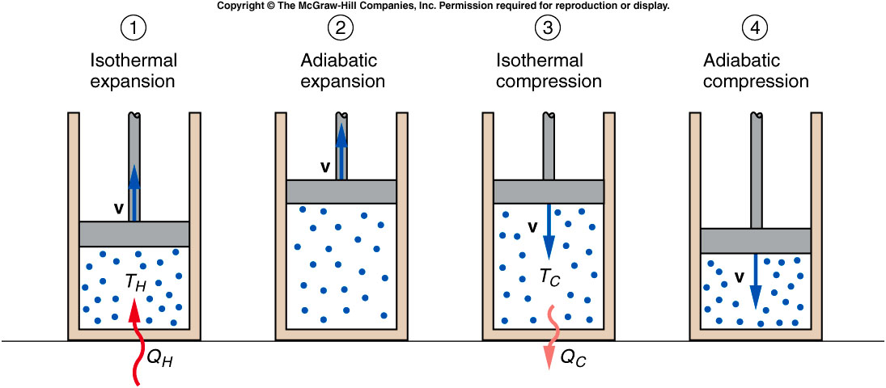
Heat flows into cylinder at temperature T_{H}. The fluid expands isothermally and does work on the piston.
The fluid continues to expand, adiabatically.
Work is done by the piston on the fluid, which undergoes an isothermal compression.
The fluid returns to its initial condition by an adiabatic compression.
Notes:
The 2nd step can not continue to be isothermal since the piston will not come back.
The last step need to be adiabatic otherwise the piston will hit the cylinder and got damaged.

Slide 7
Carnot Efficiency
The efficiency of Carnot’s ideal engine is called the Carnot efficiency and is given by:
This is the maximum efficiency possible for any engine taking in heat from a reservoir at absolute temperature T_{H} and releasing heat to a reservoir at temperature T_{C}.
The temperature must be measured in absolute degrees.
Even Carnot’s ideal engine is less than 100% efficient.

Slide 8
Entropy
entropy is an expression of disorder or randomness.
the higher the level of disorder, the higher the entropy is.
e.g. When an objected is broken into small pieces, entropy increases.
$entropy= k_{B}ln⁡(Ω)$ , where $Ω$is number of microstates
$change of entropy=\frac{∆Q}{T}$ , $∆Q$ is the change of the system heat and T is the absolute temperature of the system.
When a system absorb heat, $∆Q$is positive, i.e. entropy increase. Otherwise, the entropy decrease.

Slide 9
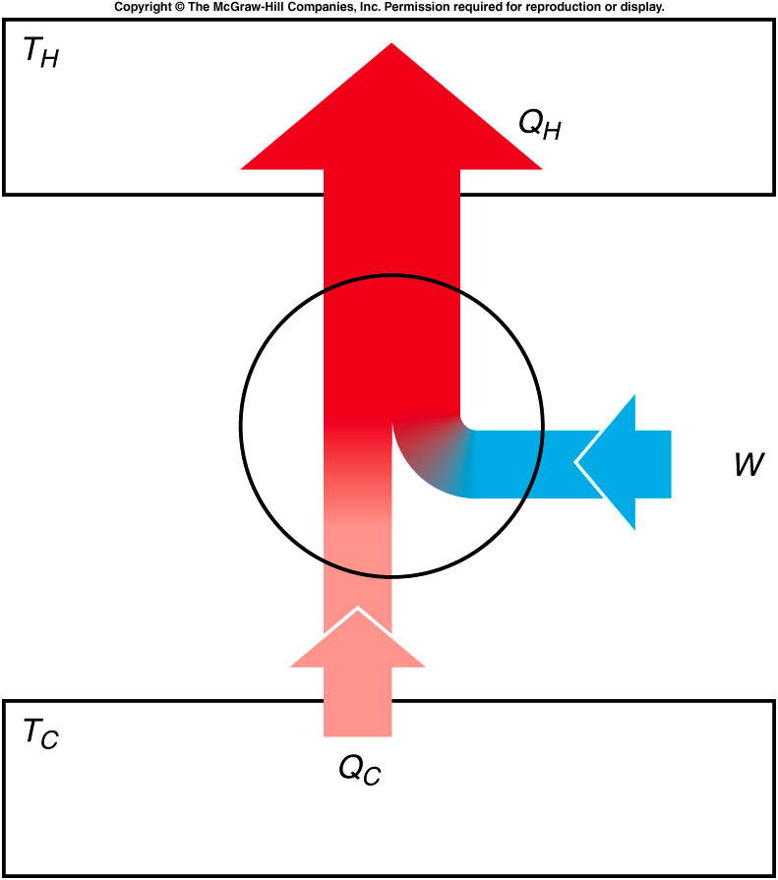
Heat Pumps, and Entropy
If a heat engine is run in reverse, then work W is done on the engine as heat Q_{C} is removed from the lower-temperature reservoir and a greater quantity of heat Q_{H} is released to the higher-temperature reservoir.
A device that moves heat from a cooler reservoir to a warmer reservoir by means of work supplied from some external source is called a heat pump.

Slide 10
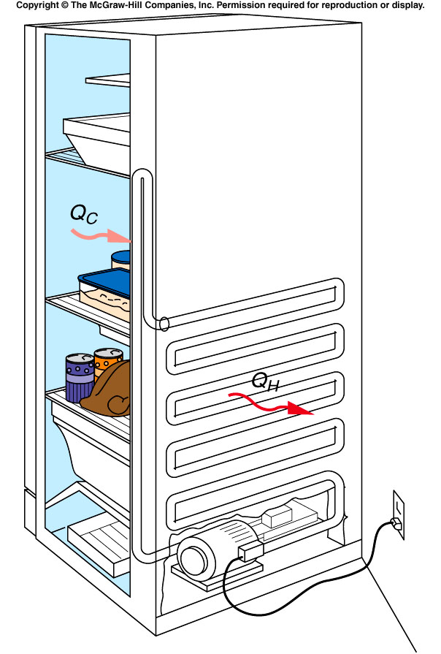
Refrigerators and Heat Pumps
A refrigerator is also a form of a heat pump.
It also moves heat from a cooler reservoir to a warmer reservoir by means of work supplied from some external source.
It keeps food cold by pumping heat out of the cooler interior of the refrigerator into the warmer room.
An electric motor or gas-powered engine does the necessary work.

